Slide 1
Guidance
Please obtain unique tagging link for each channel from the Reactor Team
AKA link and generate QR code

Slide 2
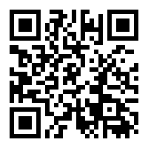
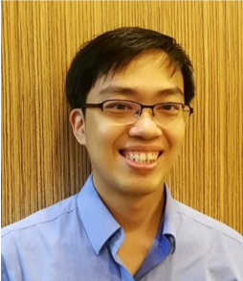
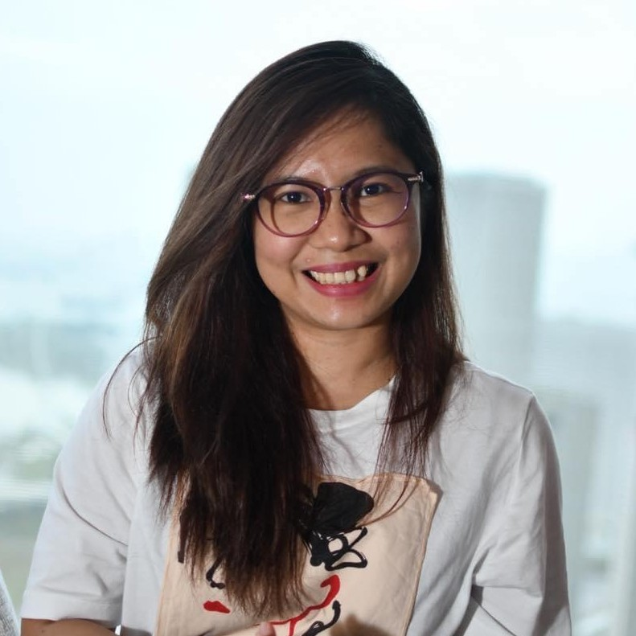
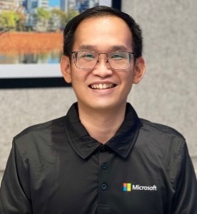
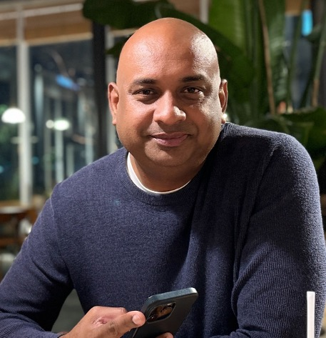
Let’s Get Technical- Singapore
Please use the appropriate aka link for the different channels
FACEBOOK
A 55-minute virtual session where we showcase
the latest innovative tech trends specific to Singapore
Join us for this free live virtual event!
Wednesday, June 28, 4PM SGT LIVE | Improve productivity with ChatGPT and Azure OpenAI
Thursday, July 6, 4PM SGT LIVE | Build apps efficiently with AI Copilot
Thursday, July 13, 4PM SGT LIVE | Deliver quality services with IaC on Azure DevOps
Register now
for this free event!
Our speakers
https://aka.ms/lets-get-technical-sg-fb
Marvin Heng
Mary Angiela Cerbolles
Vincent Kok
Sakthis Kumar
Tech Advisor, Amhere, Microsoft MVP
Product Analyst, Microsoft MVP
Technical Trainer, Microsoft
Founder, Qonsult Systems, Microsoft MVP

Slide 3
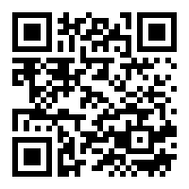
Let’s Get Technical- Singapore
Please use the appropriate aka link for the different channels
LINKEDIN
A 55-minute virtual session where we showcase
the latest innovative tech trends specific to Singapore
Join us for this free live virtual event!
Wednesday, June 28, 4PM SGT LIVE | Improve productivity with ChatGPT and Azure OpenAI
Thursday, July 6, 4PM SGT LIVE | Build apps efficiently with AI Copilot
Thursday, July 13, 4PM SGT LIVE | Deliver quality services with IaC on Azure DevOps
Register now
for this free event!
Our speakers
https://aka.ms/lets-get-technical-sg-li
Marvin Heng
Mary Angiela Cerbolles
Vincent Kok
Sakthis Kumar
Tech Advisor, Amhere, Microsoft MVP
Product Analyst, Microsoft MVP
Technical Trainer, Microsoft
Founder, Qonsult Systems, Microsoft MVP

Slide 4
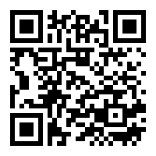
Let’s Get Technical- Singapore
Please use the appropriate aka link for the different channels
TWITTER
A 55-minute virtual session where we showcase
the latest innovative tech trends specific to Singapore
Join us for this free live virtual event!
Wednesday, June 28, 4PM SGT LIVE | Improve productivity with ChatGPT and Azure OpenAI
Thursday, July 6, 4PM SGT LIVE | Build apps efficiently with AI Copilot
Thursday, July 13, 4PM SGT LIVE | Deliver quality services with IaC on Azure DevOps
Register now
for this free event!
Our speakers
https://aka.ms/lets-get-technical-sg-tw
Marvin Heng
Mary Angiela Cerbolles
Vincent Kok
Sakthis Kumar
Tech Advisor, Amhere, Microsoft MVP
Product Analyst, Microsoft MVP
Technical Trainer, Microsoft
Founder, Qonsult Systems, Microsoft MVP

Slide 5
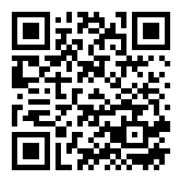
Let’s Get Technical - Singapore Improve productivity with ChatGPT and Azure OpenAI
Speakers promo only
Wednesday, June 28 | 4PM SGT | LIVE
ChatGPT and OpenAI have been drawing lots of attention from many, but is it hype or reality? Join us for this technical session as we show you what Azure OpenAI can do for businesses and how it can improve productivity and processes.
Marvin Heng
Tech Advisor, Amhere, Microsoft MVP
https://aka.ms/lets-get-technical-sg
Let’s Get Technical – Singapore is a 55-minute virtual session where we showcase the latest innovative tech trends specific to Singapore

Slide 6
Let’s Get Technical - Singapore Build apps efficiently with AI Copilot
Speakers promo only
Mary Angiela Cerbolles
Product Analyst, Microsoft MVP
Thursday, July 6 | 4PM SGT | LIVE
Supercharge your Power Apps and Power Automate experience with Copilot. With Copilot feature, helps you build apps faster and build better flows using the natural language.
Get ready to create amazing apps and flow in no time!
Vincent Kok
Technical Trainer, Microsoft
https://aka.ms/lets-get-technical-sg
Let’s Get Technical – Singapore is a 55-minute virtual session where we showcase the latest innovative tech trends specific to Singapore

Slide 7
Let’s Get Technical - Singapore Deliver quality services with IaC on Azure DevOps
Speakers promo only
Thursday, July 13 | 4PM SGT | LIVE
Sakthis Kumar
Founder, Qonsult Systems, Microsoft MVP
As software projects grow, that doesn’t mean that your work has to be more challenging. In this session, we show you how you can use IaC (Infrastructure as Code) and leverage the built-in feature of Microsoft Azure DevOps to implement your DevOps lifecycle for Infrastructure implementation, operations, and management, along with change management controls.
https://aka.ms/lets-get-technical-sg
Let’s Get Technical – Singapore is a 55-minute virtual session where we showcase the latest innovative tech trends specific to Singapore

